Slide 1
Development of an artificial intelligence for a 2 player game

Slide 2
Introduction
Project’s theme : Artificial Intelligence
Using the Min-Max algorithm
Applied on a two-players game

Slide 3
Plan
- Presentation of the min-max algorithm
- Implementation of the algorithm in a game
- Structuring of the game

Slide 4
Minimax algorithm
- For two-players zero-sum game, with complete information
- Players take alternate moves
Notes:
The Minimax algorithm can only be used for a two-player zero-sum game with complete information. That’s game who can’t finish by a double lose, and where players know all the moving possibilities. The algorithm also need that players play alternatively.

Slide 5
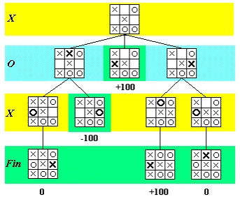
Game representation
The game can be represented by a tree :
The root is the initial situation
Each node is a potential position
An arc symbolize the move between two positions
Notes:
For all move, the algorithm create a decision tree where the root is the initial situation. We can see better with the example of noughts and crosses. We have a initial situation. An arc symbolize the move between two positions and nodes are potential position after the move. So, in the example, we have the three move that we can do. And for each node, there are two nodes who represent the opponent’s move

Slide 6
Final Situation
For each leaf we mark the game position with:
A high mark if we win
0 in the case of a draw
A low mark (negative) if we lose
Notes:
For each leaf, the algorithm mark the position. If the player win, the mark is high (one hundred in the example). If the opponent win, it’s a bad mark (here, minus one hundred). And zero if it’s a draw.

Slide 7
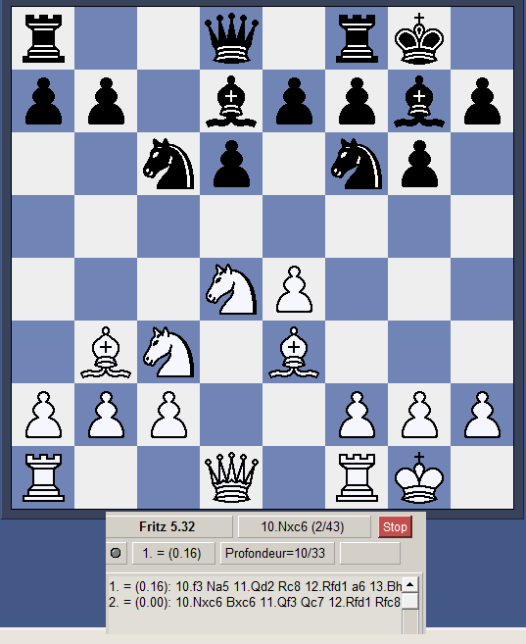
Intermediary situation
Impossible to finish the algorithm in some complex games
Using of a cost function to estimate the player's advantage
Notes:
In some complex games, the algorithm can’t go at the end of the game. So the algorithm use a cost function to estimate the player’s advantage. In the example, the algorithm only see thirty three moves in advance and it’s estimated that White are a little bit in a better position than Black.

Slide 8
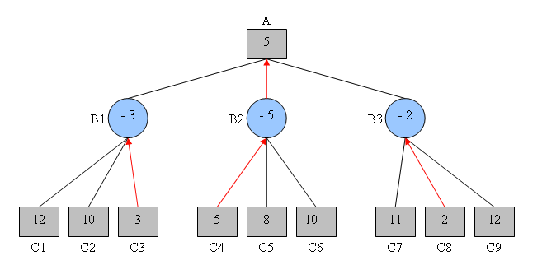
Negamax (or Max-Max)
Always represents the best move of the present player by a positive number
Take the opposite of the value when it is the opponent’s turn and use the maximum in place of the minimum

Slide 9
The Alpha–beta pruning
Objective:
Decrease number of nodes evaluated by the algorithm
How ?
Stop to develop the tree when we know that the result won’t be used

Slide 10
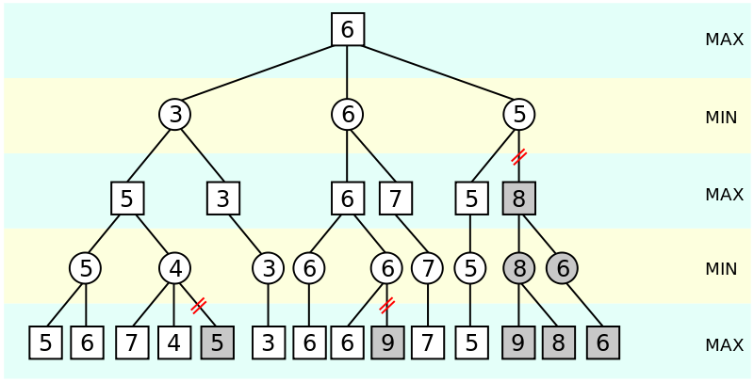

Slide 11
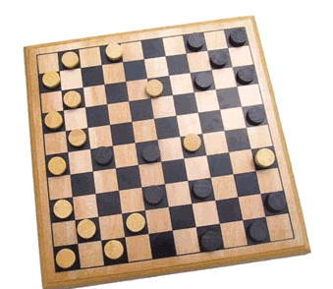
Implementation of the algorithm in a game
Possibility to work on many games:
- Connect Four
- Chess
- Checker

Slide 12
Programming choice
Language chosen : C++ for Speed execution and an easy threads implements (with open mp)
Graphic library chosen : QT

Slide 13
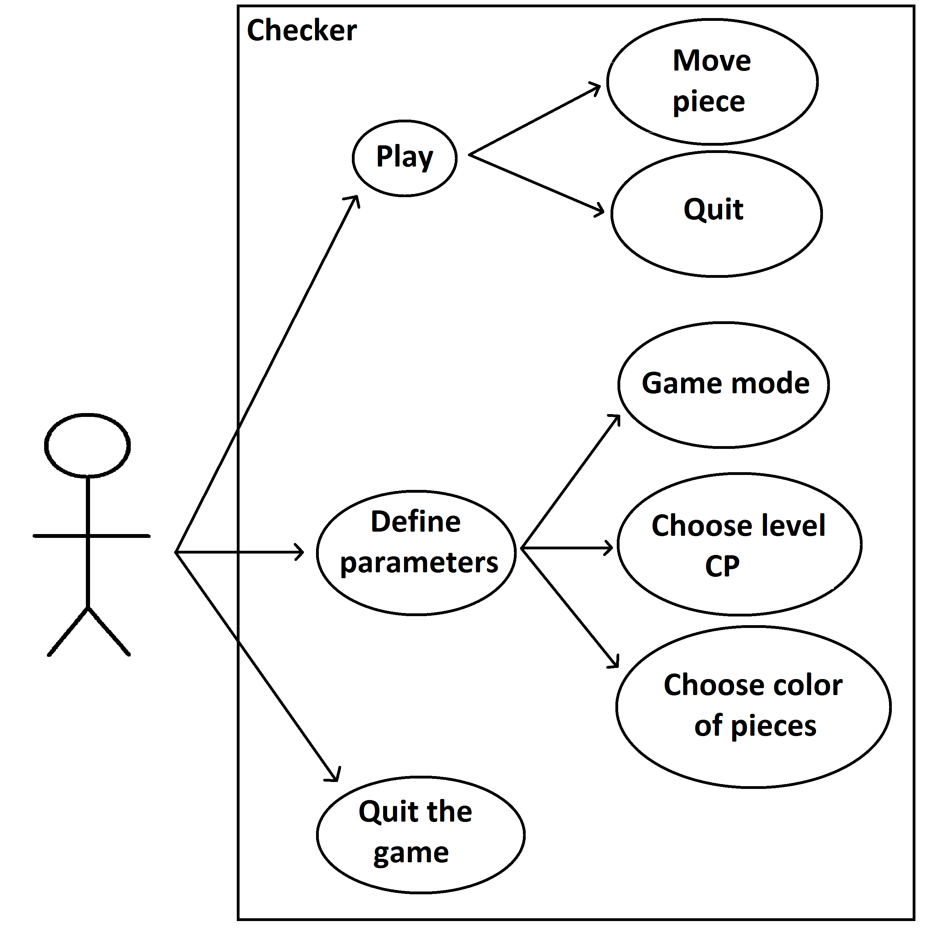
Game possibilities for players

Slide 14
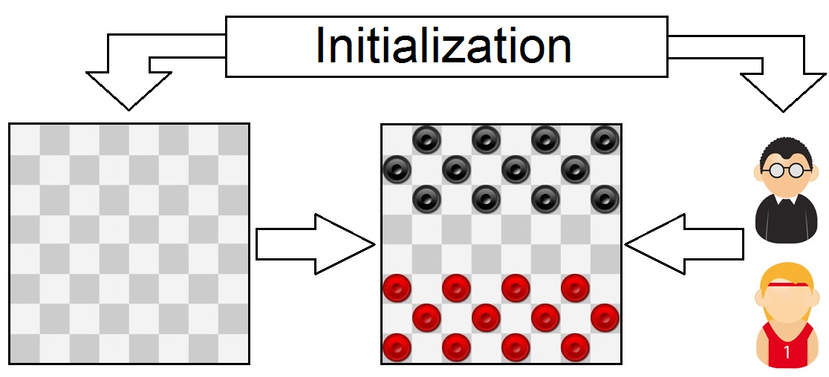
Game structure

Slide 15
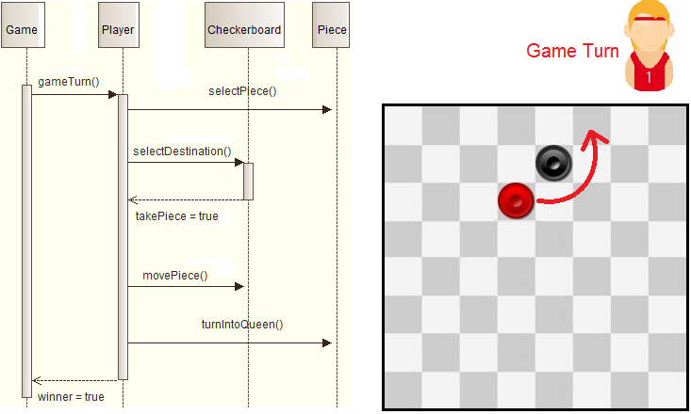
Game proceeding

Slide 16
Conclusion
Knowledge about the Min-Max algorithm
Game structure created in C++
Ready to implement

